Slide 1



OWASP en .NET: Cifrado

Slide 2
Agenda
Recapitulación
Encodificación vs. Encriptación vs. Hashing vs. Obfuscación
Algoritmos
Ejemplos prácticos
info@megsoftconsulting.com

Slide 3
Recapitulación

Slide 4
Top 10 OWASP
Injection
Weak authentication and session management
XSS
Insecure Direct Object References
Security Misconfiguration
Sensitive Data Exposure
Missing Function Level Access Control
Cross Site Request Forgery
Using Components with Known Vulnerabilities
Unvalidated Redirects and Forwards

Slide 5
Encodificación vs. Encriptación vs. Hashing vs. Obfuscación
Notes:
https://danielmiessler.com/study/encoding-encryption-hashing-obfuscation/

Slide 6
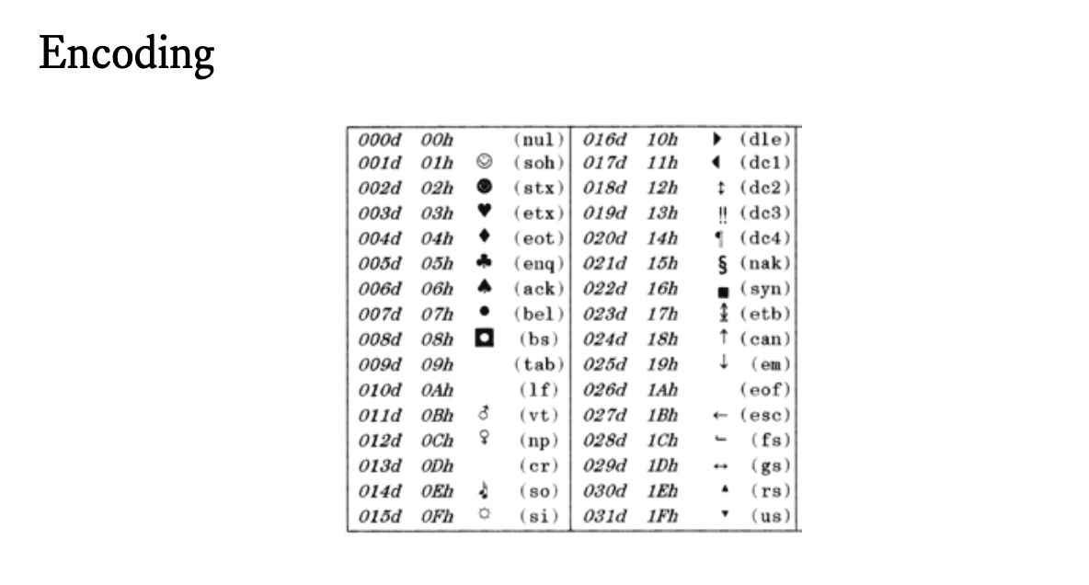

Slide 7
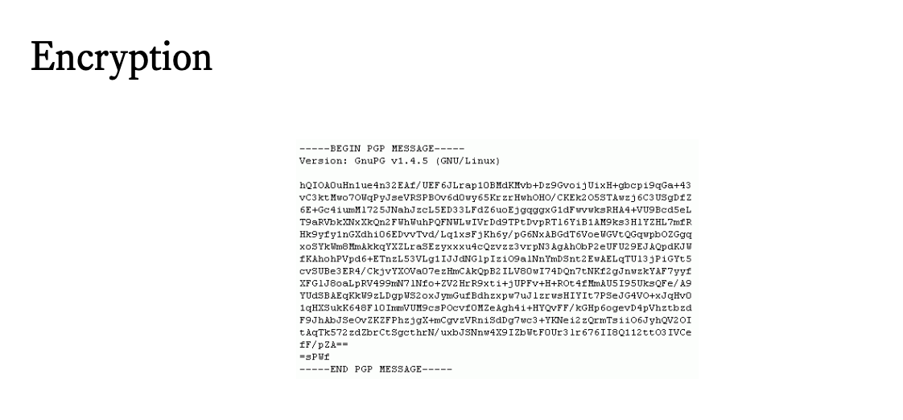

Slide 8
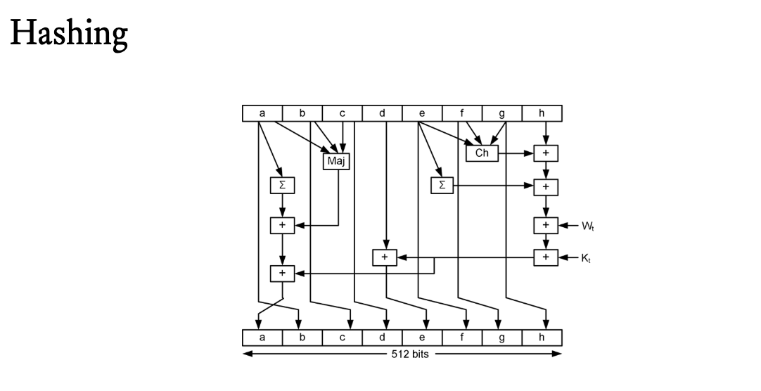

Slide 9
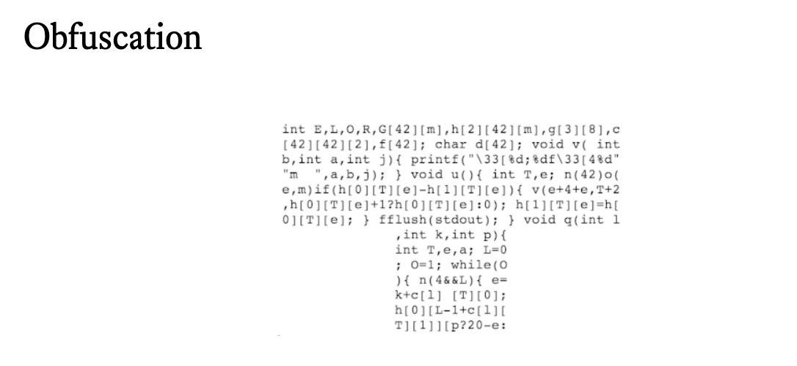

Slide 10
Encoding
Encriptación
Hashing
Ofuscación
ASCII
Unicode
URL Encoding
Base64
AES
BLOWFISH
RSA
SHA
MD5
Javascript obfuscator
Proguard

Slide 11


Slide 12
What’s next?
Cross Site Scripting (XSS)

